Slide 1
Air Quality Monitoring System using IOT

Slide 2
Introduction
In an era where environmental concerns and health considerations take center stage, the quality of the air we breathe has never been more critical. Poor air quality poses a significant threat to our well-being and the environment.
To address this challenge effectively,We delve into the fascinating world of “Air Quality Monitoring Using ESP-32 and Internet of Things.” This presentation will unveil how the powerful ESP-32 microcontroller, combined with the capabilities of the Internet of Things (IoT), enables us to track and manage air quality.

Slide 3
IoT
Now, let’s introduce our key player—the ESP-32 microcontroller. This compact and versatile device boasts a wide range of capabilities, making it an ideal choice for IoT applications. It serves as the brains behind our air quality monitoring system, ensuring that data is collected accurately and efficiently.
The Internet of Things (IoT) describes the network of physical objects—“things”—that are embedded with sensors, software, and other technologies for the purpose of connecting and exchanging data with other devices and systems over the internet. These devices range from ordinary household objects to sophisticated industrial tools.

Slide 4
ESP32
Now, let's introduce our key player—the ESP-32 microcontroller. This compact and versatile device boasts a wide range of capabilities, making it an ideal choice for IoT applications. It serves as the brains behind our air quality monitoring system, ensuring that data is collected accurately and efficiently.
The ESP32 is a low-cost, low-power system on a chip (SoC) microcontroller with integrated Wi-Fi and dual-mode Bluetooth. It’s designed by Espressif Systems21 and is capable of functioning reliably in industrial environments, with an operating temperature ranging from –40°C to +125°C2.
It’s engineered for mobile devices, wearable electronics, and Internet-of-Things (IoT) applications, achieving ultra-low power consumption with a combination of several types of proprietary software. ESP32 can perform as a complete standalone system or as a slave device to a host MCU, reducing communication stack overhead on the main application processor.

Slide 5
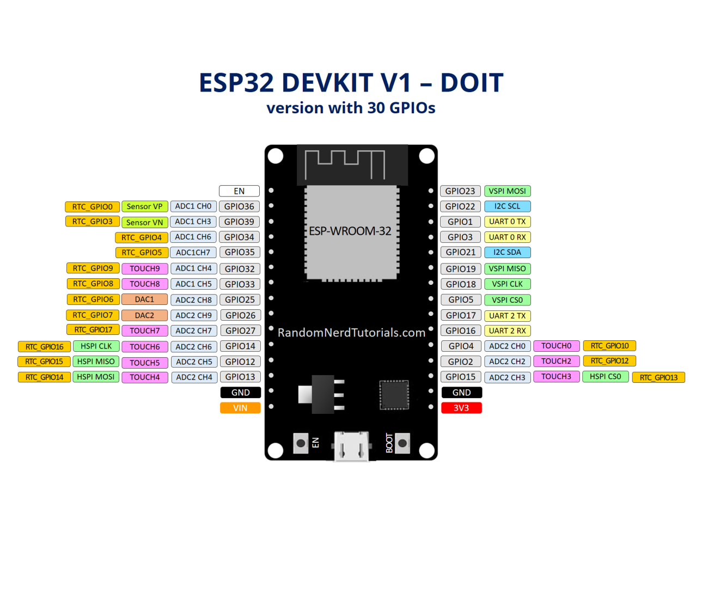
ESP32

Slide 6
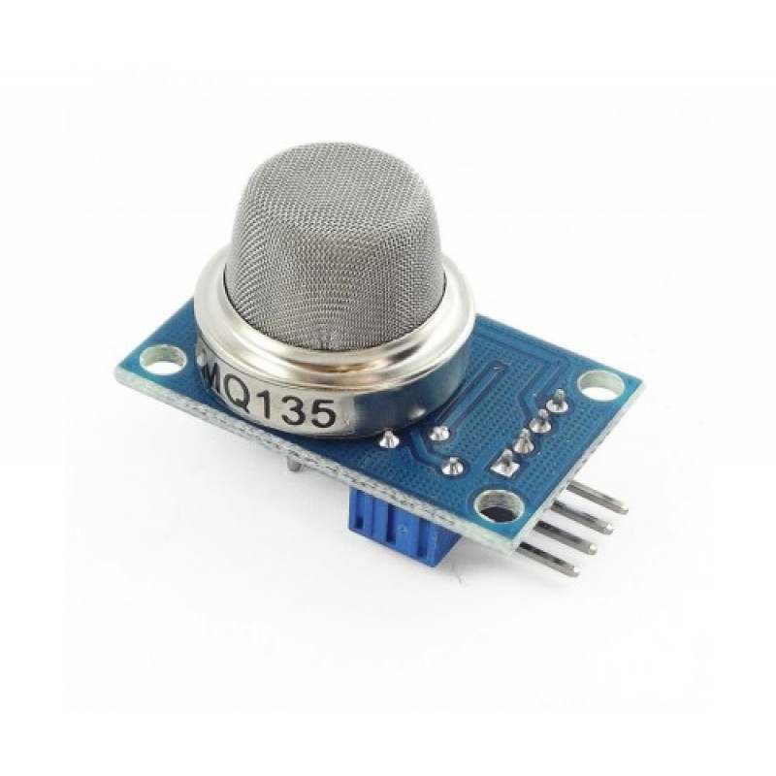
Sensor :
The MQ135 sensor is a type of air quality gas sensor that is used to detect, measure, and monitor a wide range of gases present in the air like ammonia, alcohol, benzene, smoke, carbon dioxide, etc.
It operates at a 5V supply with 150mA consumption. Preheating of 20 seconds is required before the operation, to obtain the accurate output.

Slide 7
Project Model
1. Home Page:
A dynamic map showing air quality data from various locations.
Users can zoom in/out and click on specific locations to get more detailed data.
A search bar for users to find specific locations.
Real-time air quality index (AQI) displayed prominently.
2. Location-specific Page:
Detailed air quality data for the selected location, including levels of different pollutants (PM2.5, PM10, NO2, SO2, CO, O3).
Historical data and trends over time.
Health advisories based on current air quality.
3. Data Page:
Allows users to download raw data for their own analysis.
Provides APIs for developers to access and use the data.
4. About Page:
Information about the platform, data sources, how the AQI is calculated, etc.
5. User Account:
Users can create an account to save their favorite locations and set up notifications for AQI changes.
Remember, this is just a basic design. Depending on your specific needs and resources, you might want to add more features or details. For example, you could add a feature that predicts future air quality based on historical data and weather forecasts. Or you could provide more detailed health advisories, like recommending when to wear masks or when it’s safe to exercise outdoors. You could also consider making the platform mobile-friendly or developing a mobile app version.

Slide 8
Benefits of Air Quality Monitoring
Preservation of Ecosystems: Monitoring air quality aids in identifying pollutants that harm ecosystems, including forests, bodies of water, and wildlife. Protecting air quality supports the preservation of diverse habitats.
Improved Respiratory Health: Monitoring air quality helps identify harmful pollutants such as PM2.5, PM10, and VOCs, which can lead to respiratory issues. By avoiding exposure to high levels of these pollutants, individuals can protect their lung health.
Scientific Advancements: Continuous air quality monitoring contributes to scientific research on pollution patterns, health impacts, and the development of effective pollution control strategies.

